Slide 1
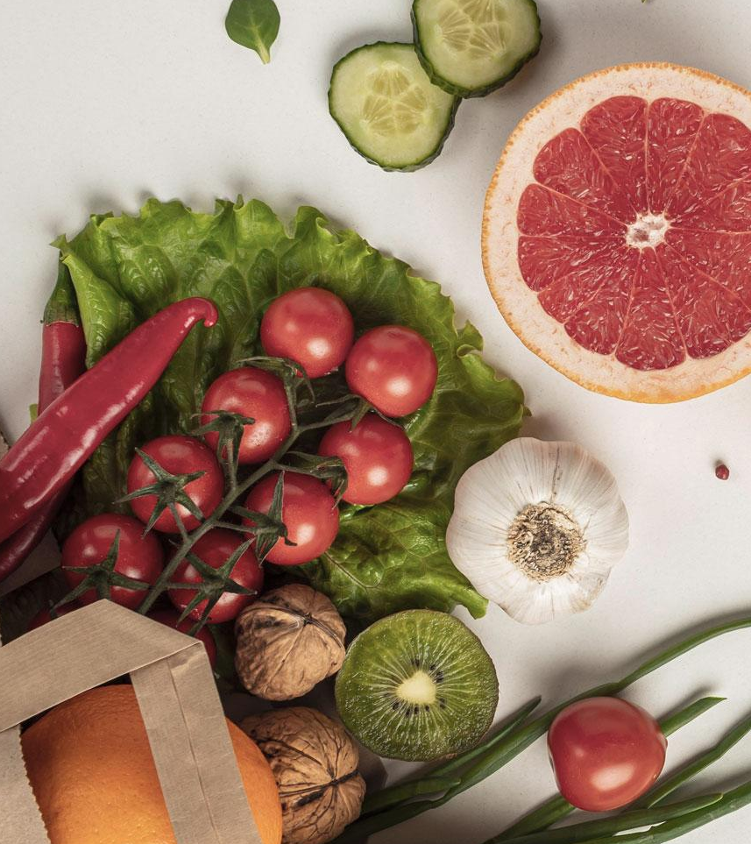
Tasty Bites
Farah Hesham 19104737
Salma Ashraf 19104695
Ammar Yasser 19106256

Slide 2
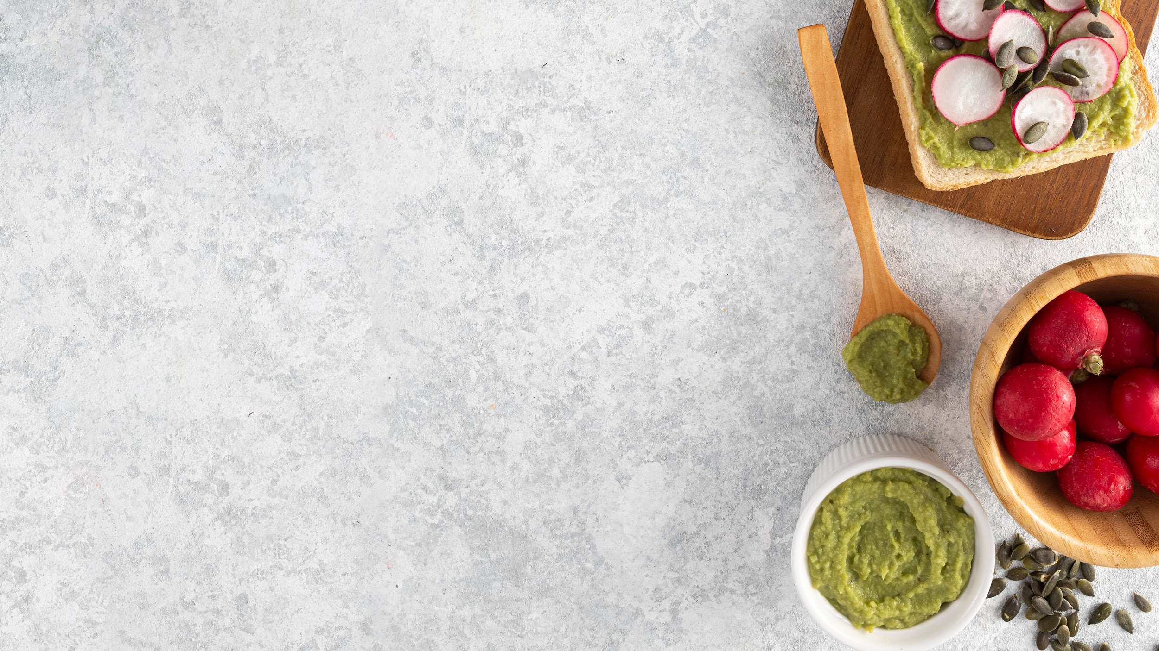

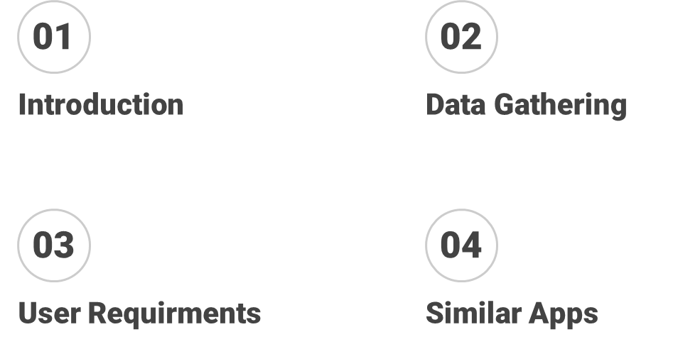

Slide 3
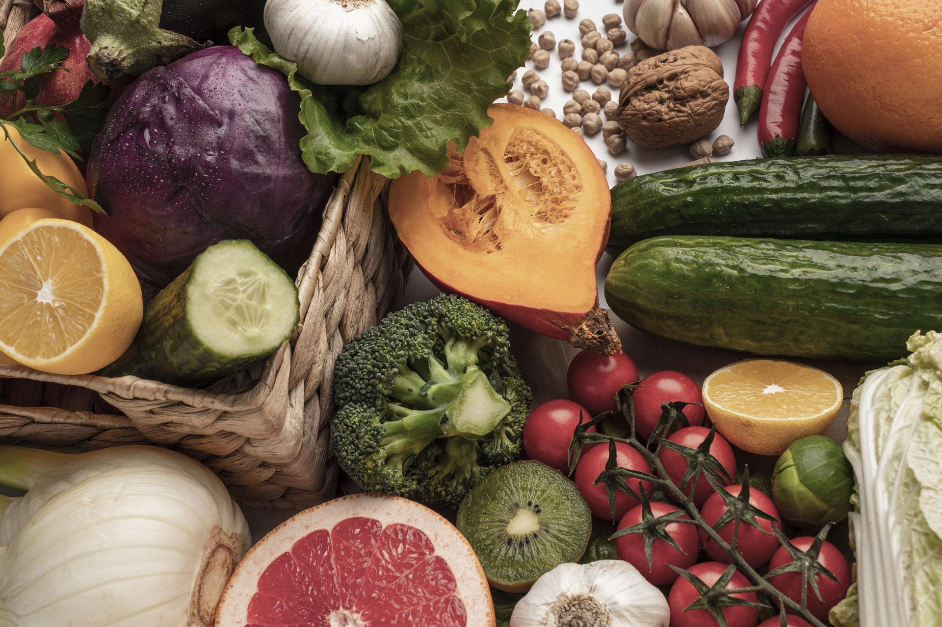
01
Introduction

Slide 4
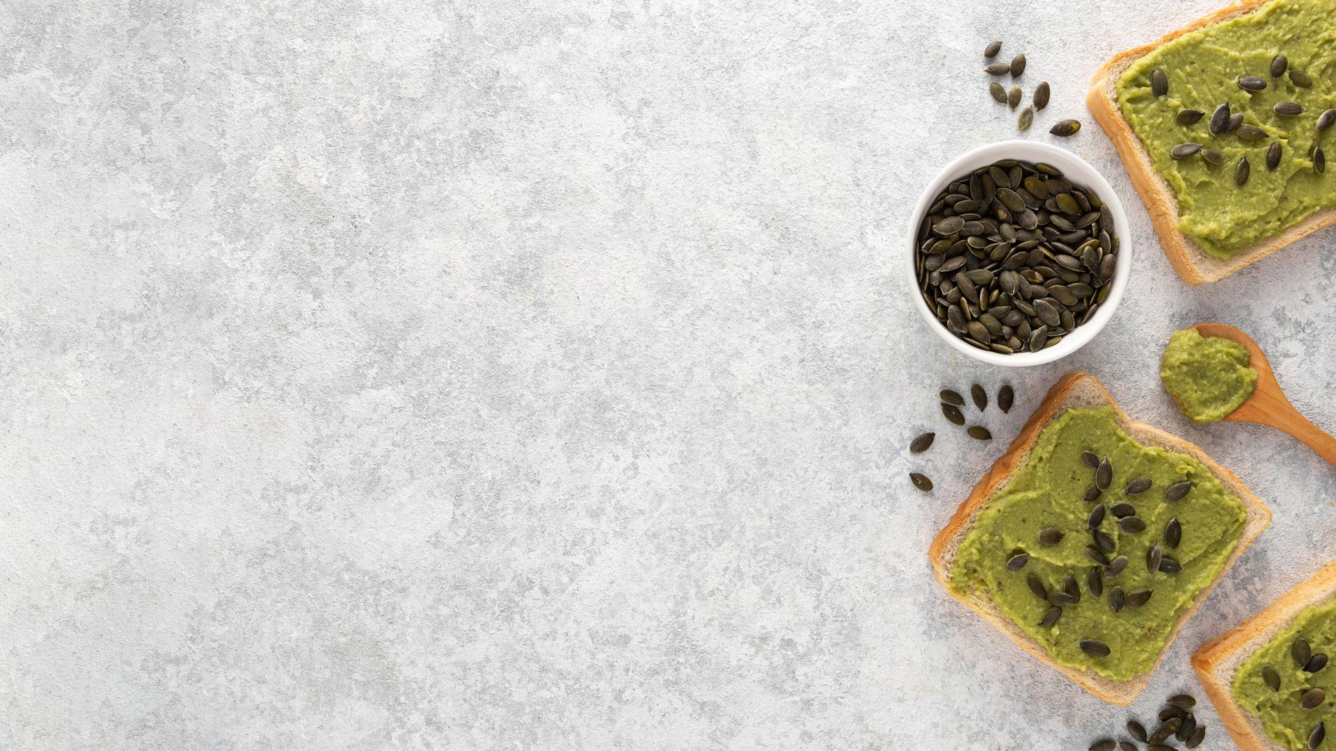
What is Tasty Bites?
Tasty Bites is an Application & Website that provide healthy habits to people.
Mainly people can order healthy food from it & also plan their diet.
Tasty bites provides food which is healthier and less calories besides that it is delicious.
Also, it provides healthy tips to people and how they can have a healthy lifestyle.

Slide 5
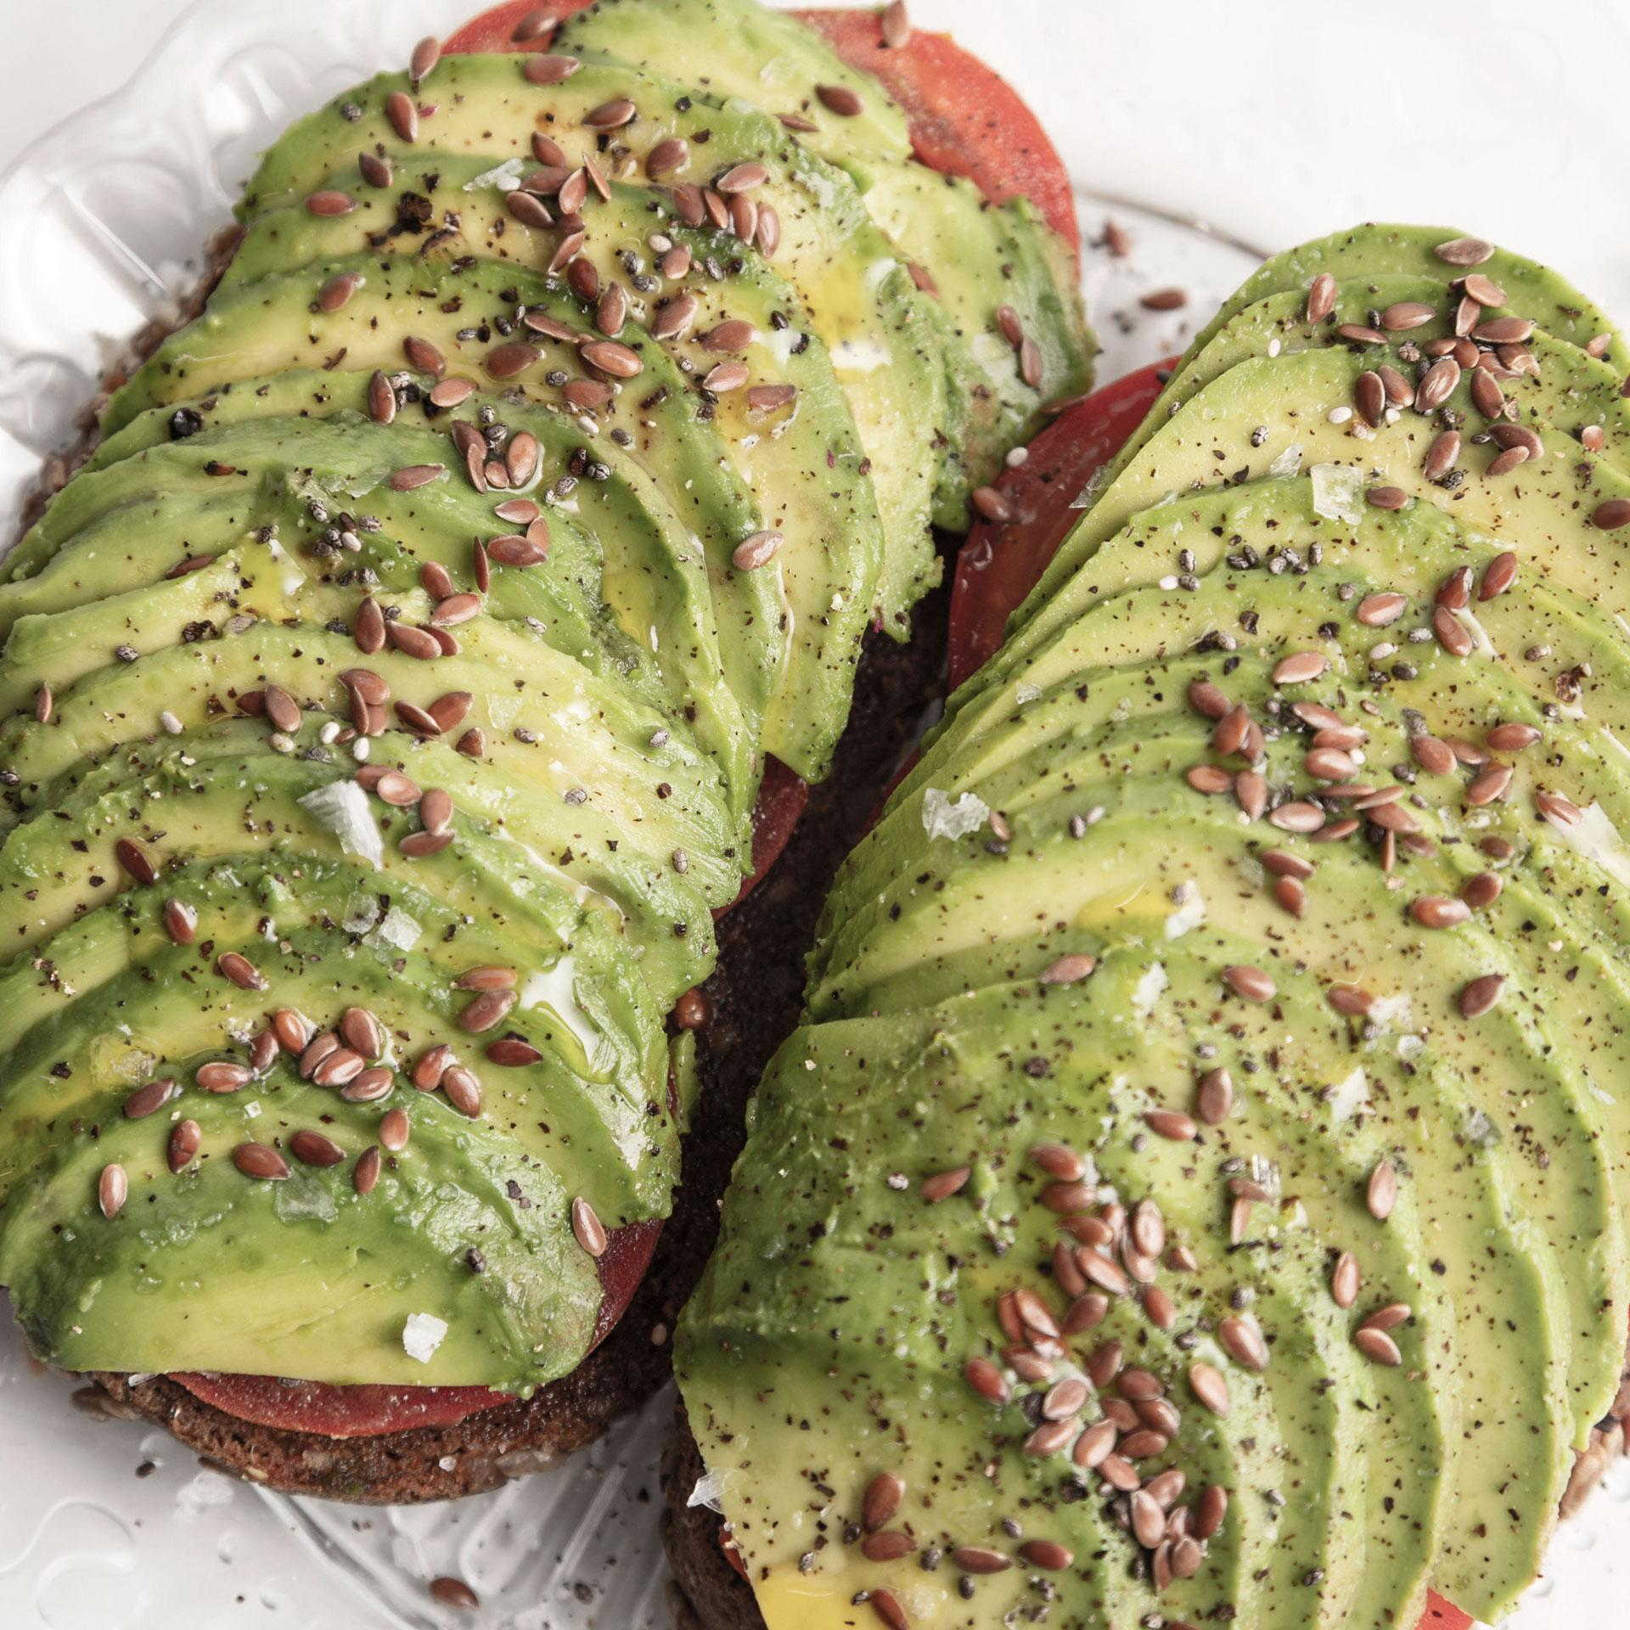


Encourage healthy eating habits.
Provide personalized meal plans.
Offer nutritional information.
Facilitate recipe discovery.
Enhance user engagement.
Foster education and awareness.
Continuously improve user experience.
Collaborate with health experts

Slide 6
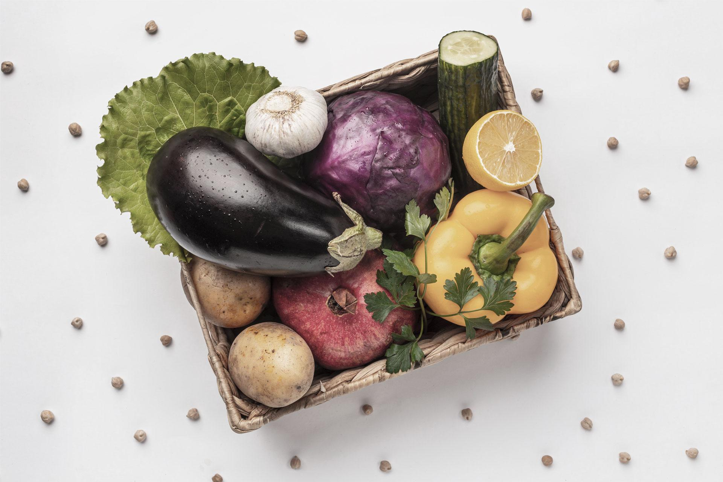
Data Gathering.
02

Slide 7
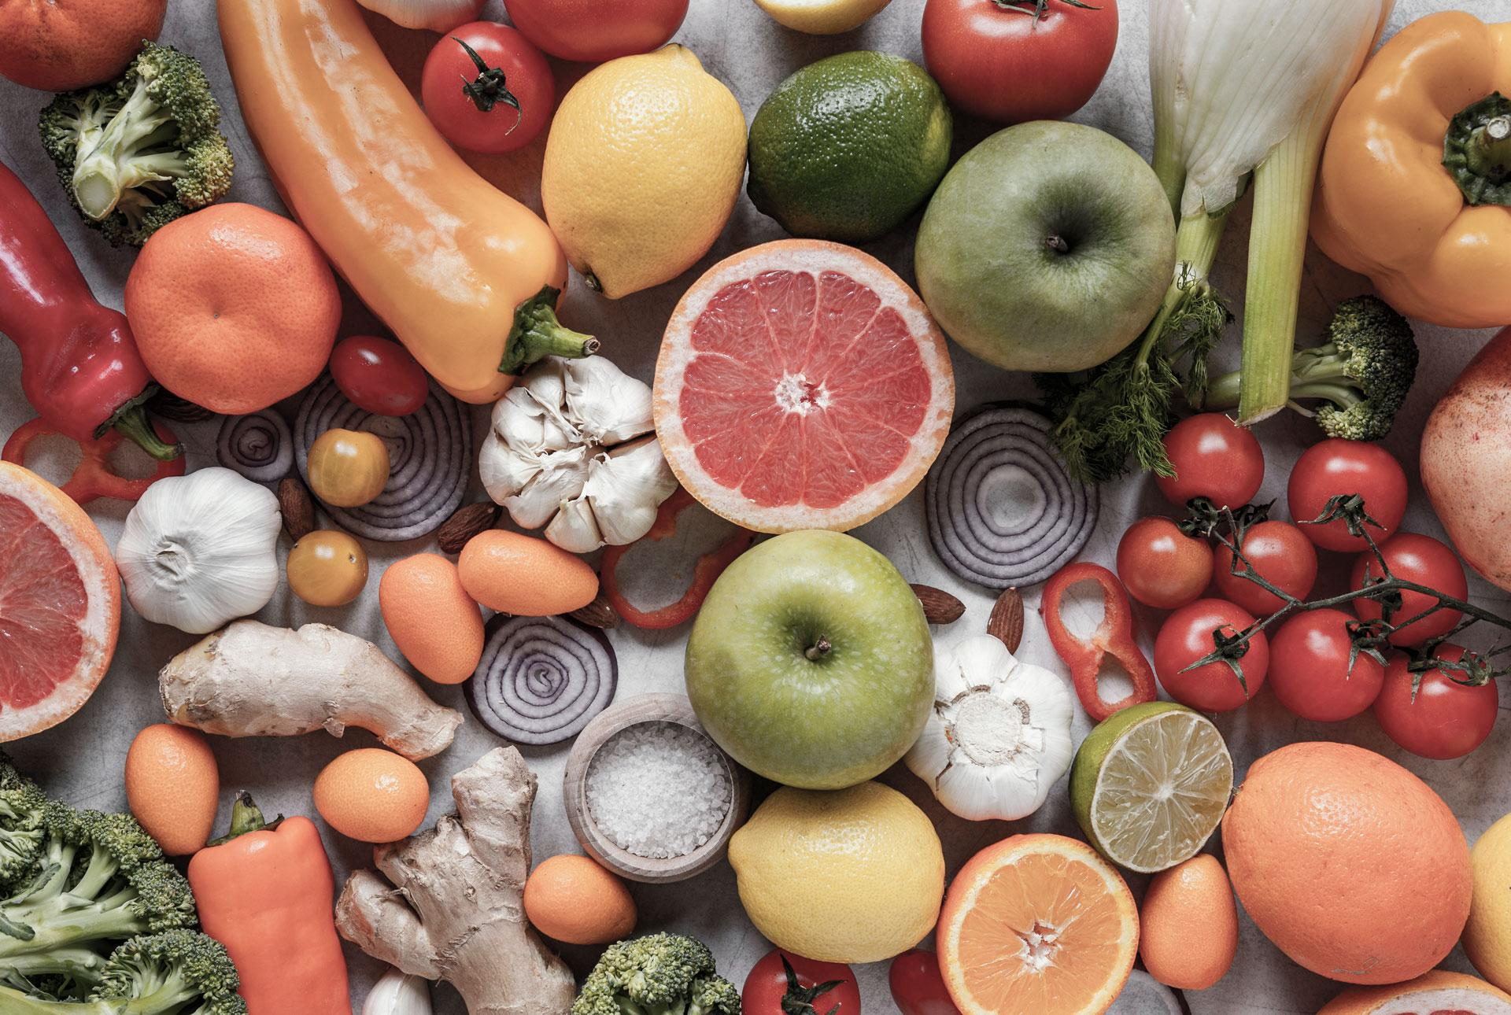
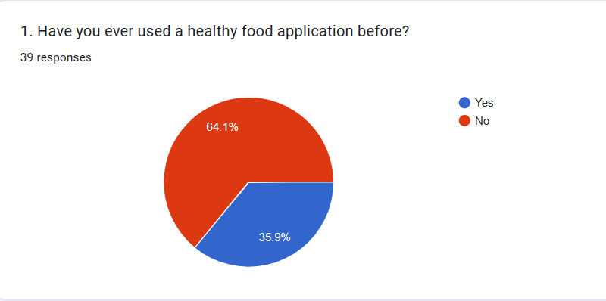
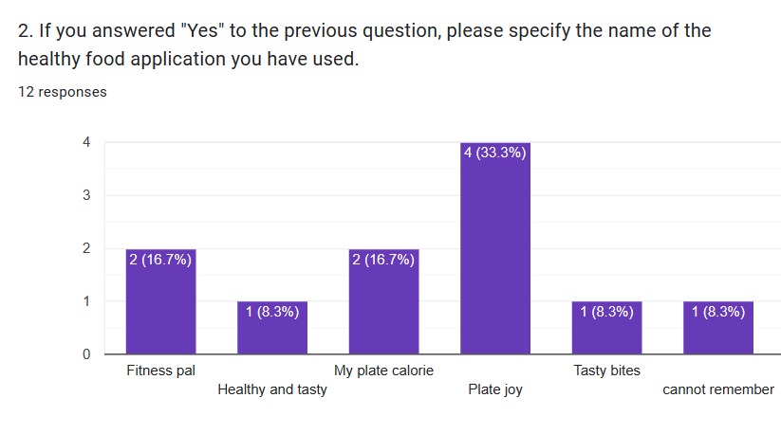

Slide 8
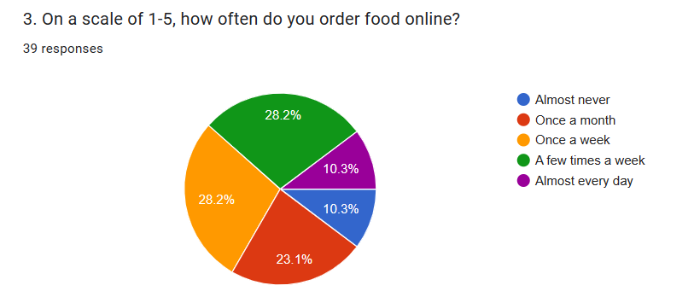
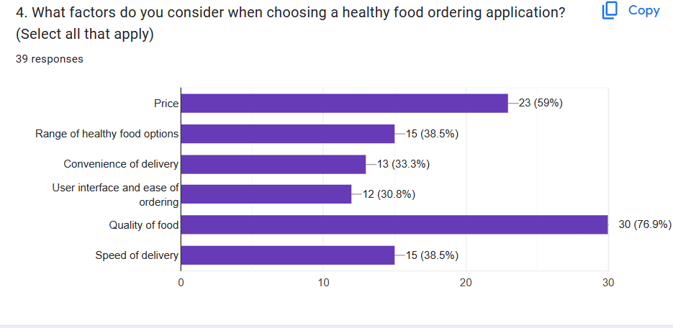

Slide 9
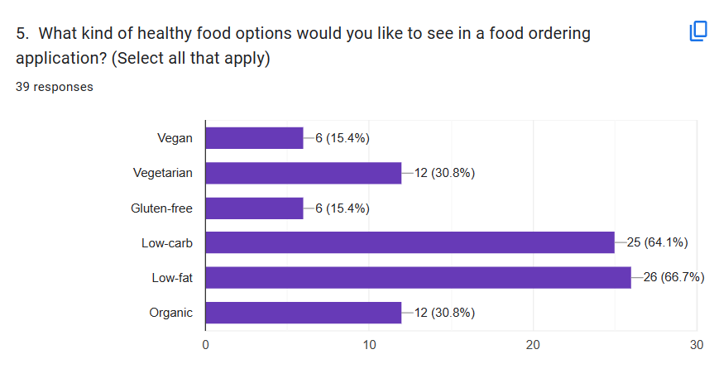
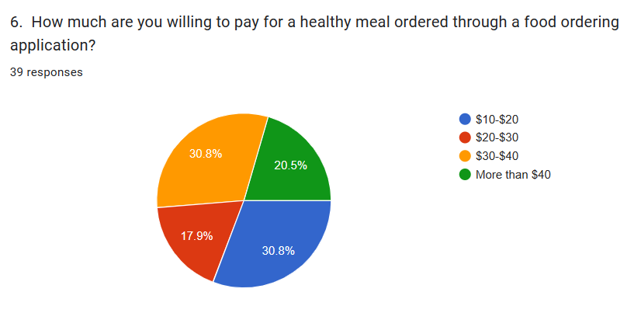

Slide 10
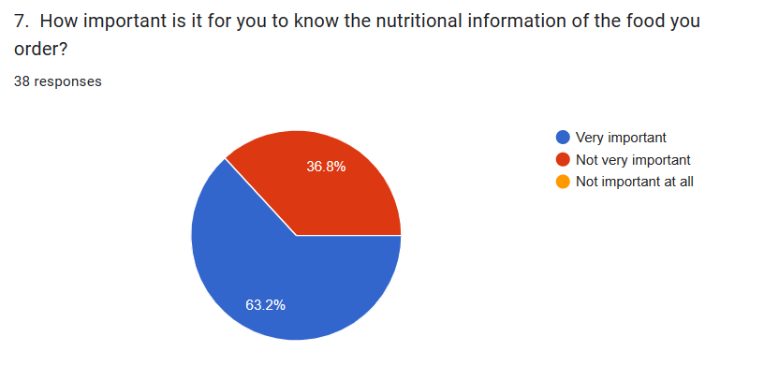
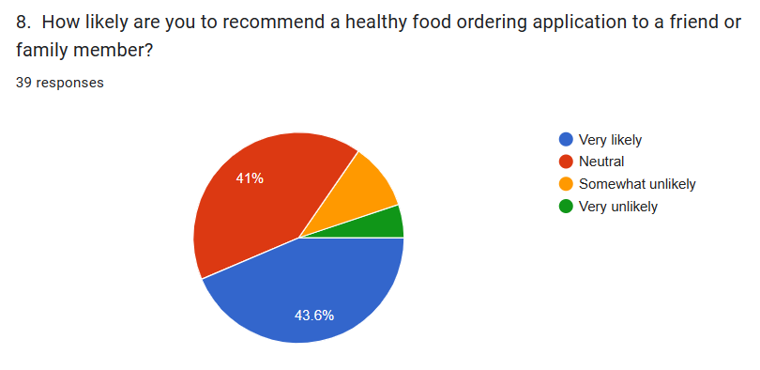

Slide 11
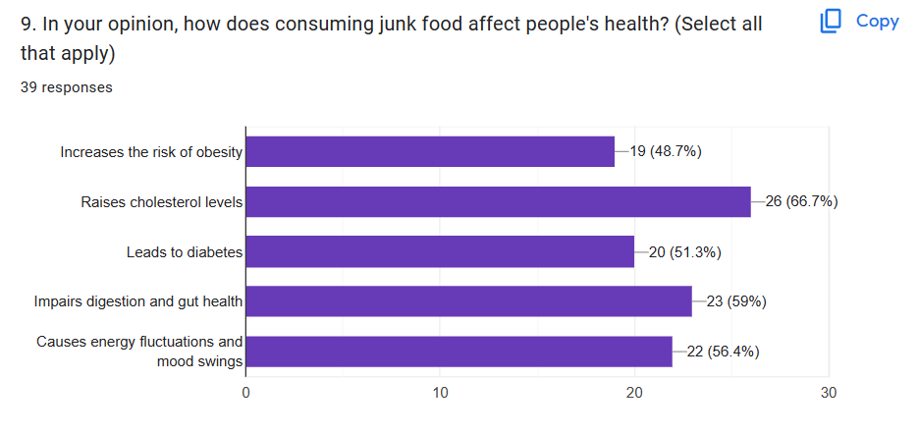
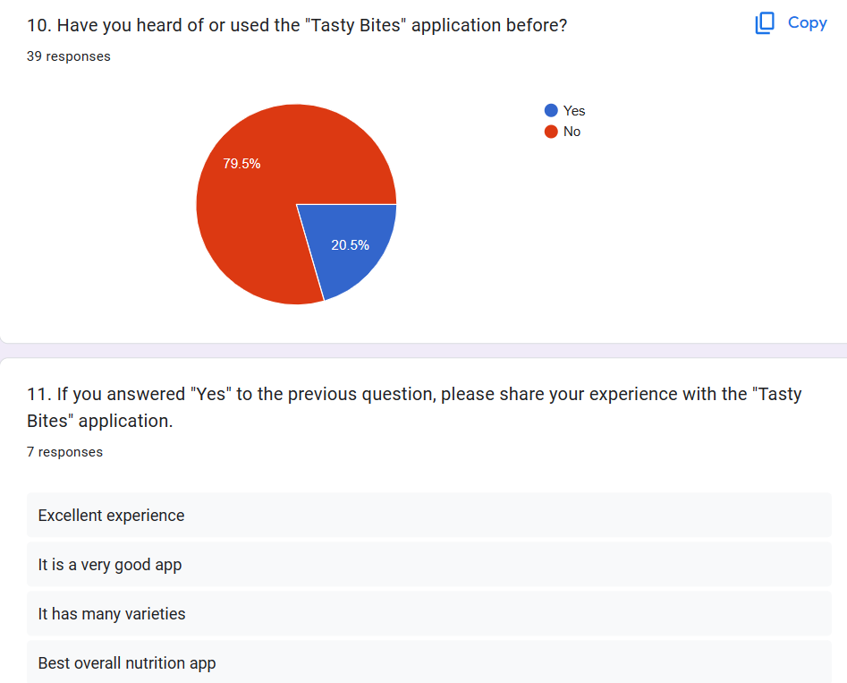

Slide 12
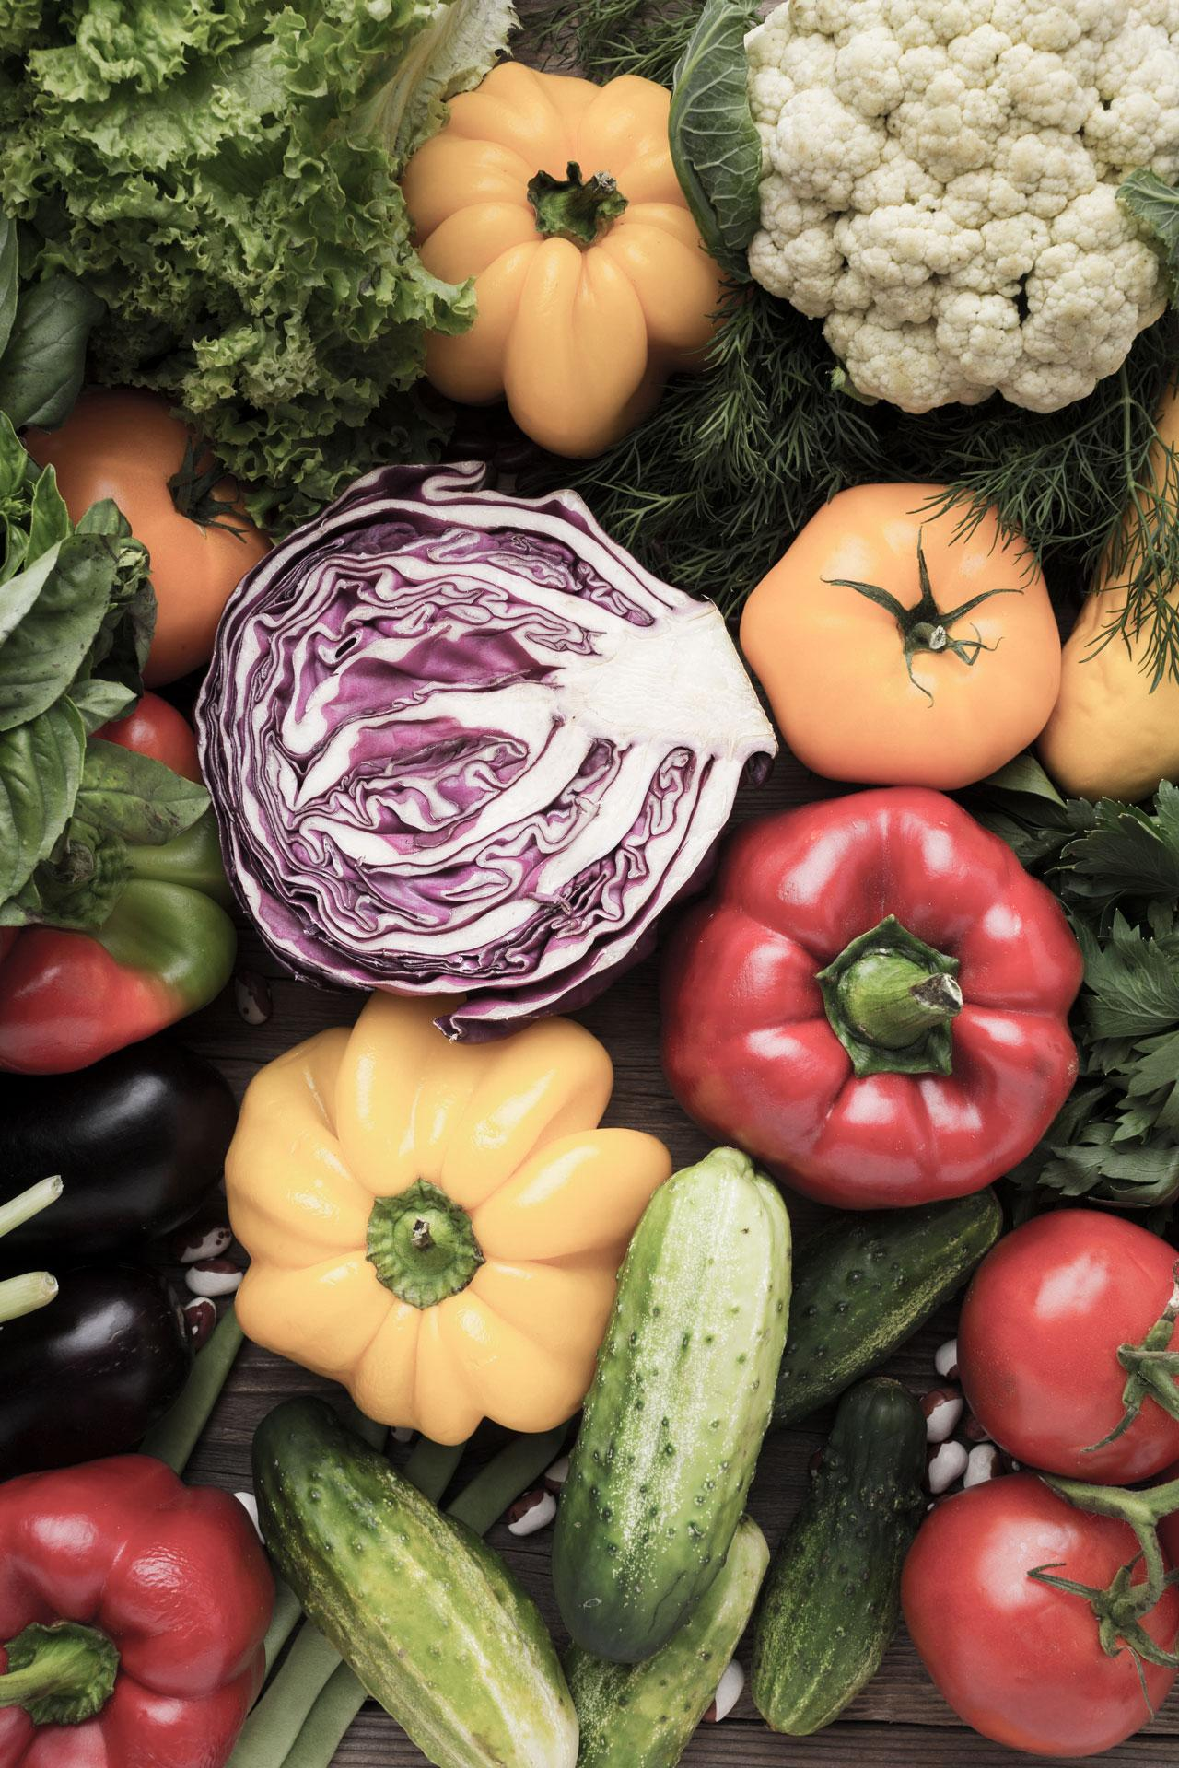
03
User Requirments

Slide 13
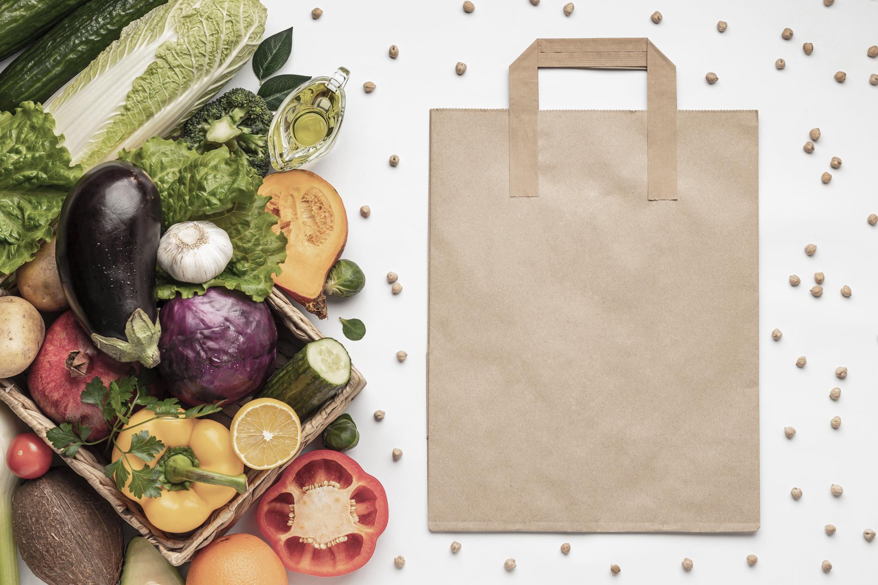
An affordable price
Food quality
Fast Delivery
Most of the people pay a lot of money in healthy food so they want a reasonable prices.
According to the results it matters to the people the food quality.
It is important to them that the food don’t be late, or at least comes to their estimated time.

Slide 14
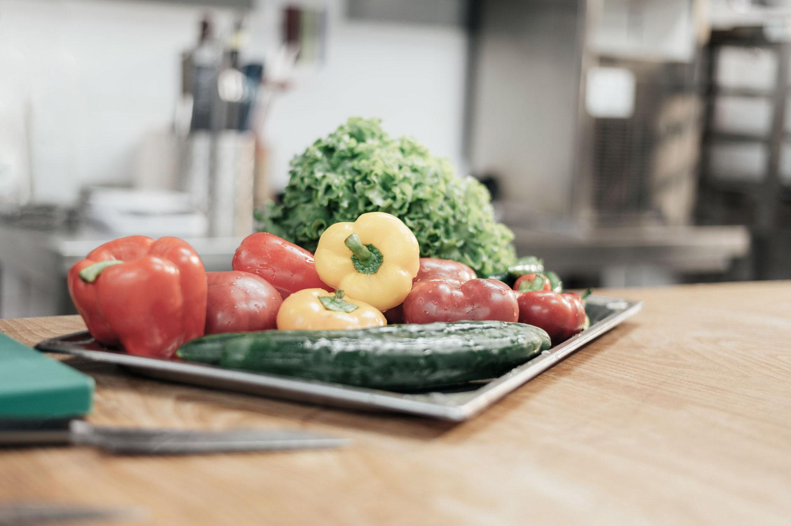
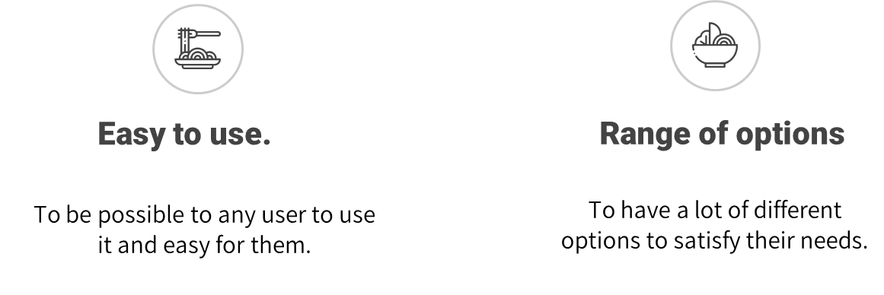

Slide 15
04
Similar Apps

Slide 16
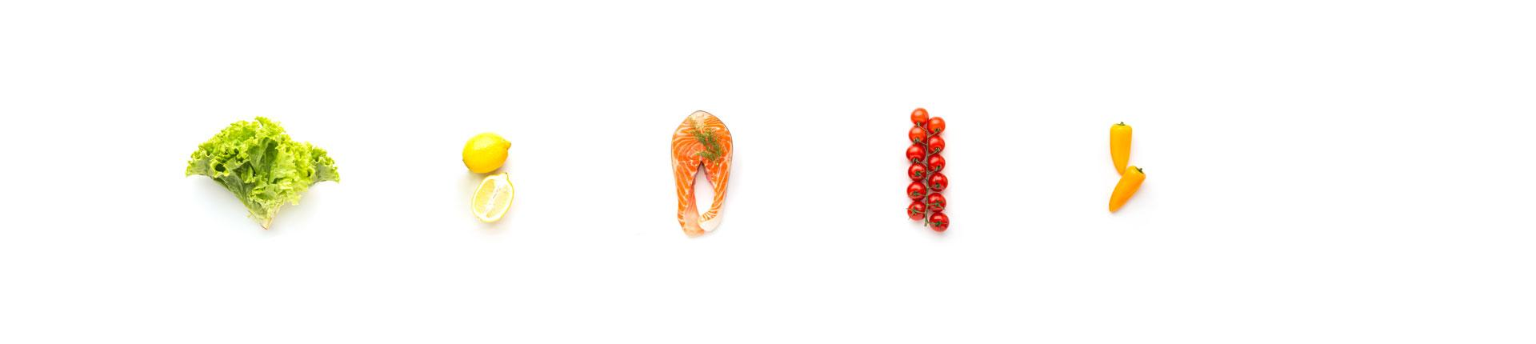
1
3
5
Freshly
Grubhub
MyFitnessPal
Sprig
HealthyOut
2
4

Slide 17

Applications UI/UX Problems
Freshly
Grubhub
Sprig
Some users reported that the app is slow and laggy, others with the search functions that return irrelvant results.
Some users reported issues in the checkout process, as it is confusing.
Some users reported issues with the app users' interface , difficult and confusing to navigate.
Overwhelming the menu has a lot of options to choose from.

Slide 18
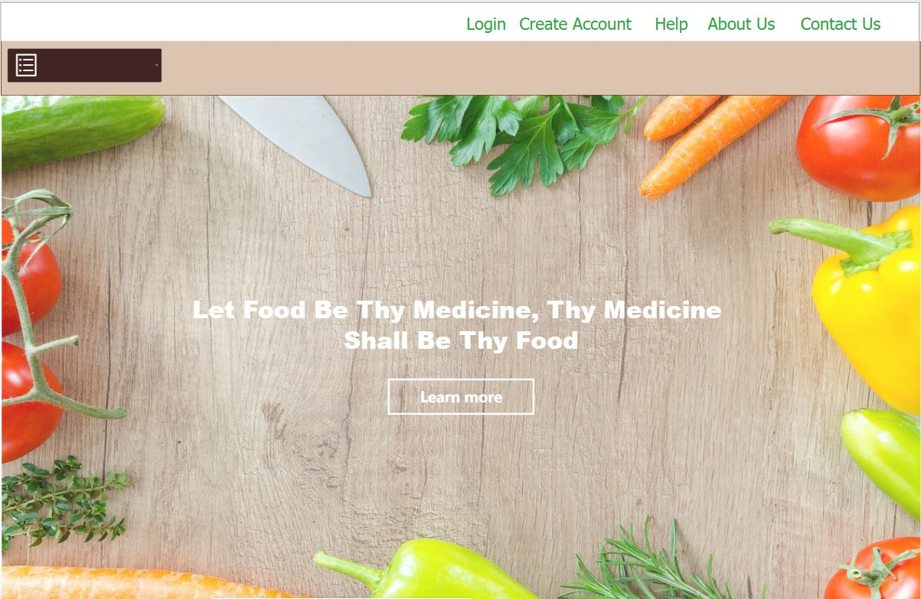
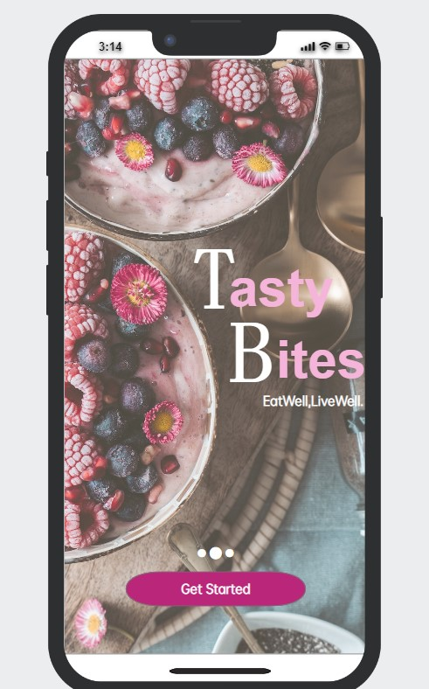
Website
Mobile Application

Slide 19
Thank You.

